Slide 1

DSCI 551 Project – Emulating Firebase
Topic : Los Angeles Traffic Collision data analysis
ANINDITA GHOSH
USC ID : 3898202691
Notes:
Today I will talk about Emulating the functioning of a big database system. I have chosen to emulate Firebase using MySql as the backend database server. The topic for my project is Los Angeles …… The data contains details of victims of traffic accidents in different areas of LA in the last 1 decade.

Slide 2
Motivation
Helpful for new people/international students to learn about traffic safety.
Good for beginners.
Helps map CURL operations with SQL queries.
Notes:
USC is a place where students from different countries learn. Being an international student myself, when I first came to USC I was looking to stay in a place with traffic safety. I wasn’t familiar with the areas so I wanted to know what was the traffic picture there, is it safe for students, how many accidents took place here. This thought inspired me to work eith the traffic data. In the beginning of the sem, we learnt Firebase -> was familiar with SQL-> thought if there would be any application to map the Firebase commands with the equivalent SQL query for better understanding, So, together these thoughts made me choose the topic. This appl. Is immensely valuable for newbies to BigData systems to learn about how Firebase commands work using equivalent SQL queries.

Slide 3
Project Overview
An application that emulates Firebase Database using MySQL as the backend database server.
Provides support for Firebase CURL commands GET, POST, PUT, PATCH and DELETE.
Shows all details(Age, Descent, Address) of victims.
Notes:
In a nutshell, my appl. Is one that emulates the functioning of Firebase BigData system. In Firebase we use CURL commands so of course as the name implies, this application runs for all CURL commands and shows the results in the same format as Firebase i.e. JSON. Also this appl. Would help people learn about different details of the victims like their ethnicity, age, personal details like address as well as exact coordinates of the location of the accident.

Slide 4
Implementation:
Data inserted to database using .py file
Server .py file started
Flask listens to port and intercepts request
CURL commands entered from terminal
Flask listens and redirects request to method(PUT, POST etc.)
SQL command runs and returns results to terminal
Notes:
This is a block diagram representing the processes that take place in order for implementation of the project. Starting from First, I efficiently transfer the data from CSV file to a MySQL database using a .py file. Next I start the server.py file. This will be the file responsible for handling different requests like GET,POST and show the results. Here I have used Flask to listen to a port and intercept the requests coming in. We do have alternatives like Node.js, React.js but I prefer Flask because Flask is the best for building web application that is highly extendable and customisable.
Next From the terminal, I enter the CURL commands like CURL –X POST… Flask catches the request and redirects it to the specific method to be triggered like for GET it triggeres the method to handle all GET requests, for POST it does the same….In the last block, inside the methods, the equivalent SQL queries run and show the results back to terminal in JSON format like Firebase.

Slide 5
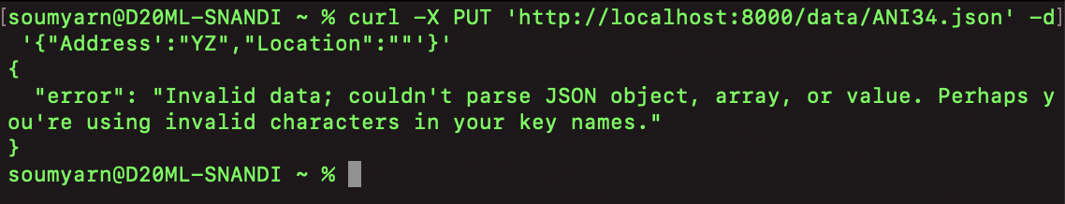
Process of Pipeline
Flask catches requests.
Methods(GET/POST/PUT) triggered
Body of CURL command analyzed
(curl -X PATCH 'http://localhost:8000/data/ANI35.json' -d '{"Address":"ghgh"}’)
SQL query runs (UPDATE data set…)
Results returned to terminal.
Invalid JSON error displayed.
Notes:
This is kind of a pseudocode that I have written using an instance of a CURL command. As discussed earlier, Flask catches the request and triggers the soecific method. Next, the body of the command is examined e.g. lets say I entered a CURL command like curl –X PATCH…… In Firebase PATCH is usd to update a record so here it constructs the equivalent SQL query like ‘UPDATE data set ….’ with the key. The results of the command ar ethen returned to terminal like in Firebase. To be noted, with a problem in the JSON format of data, it would show an error like above – similar to Firebase. Notice there’s an error after Location.

Slide 6
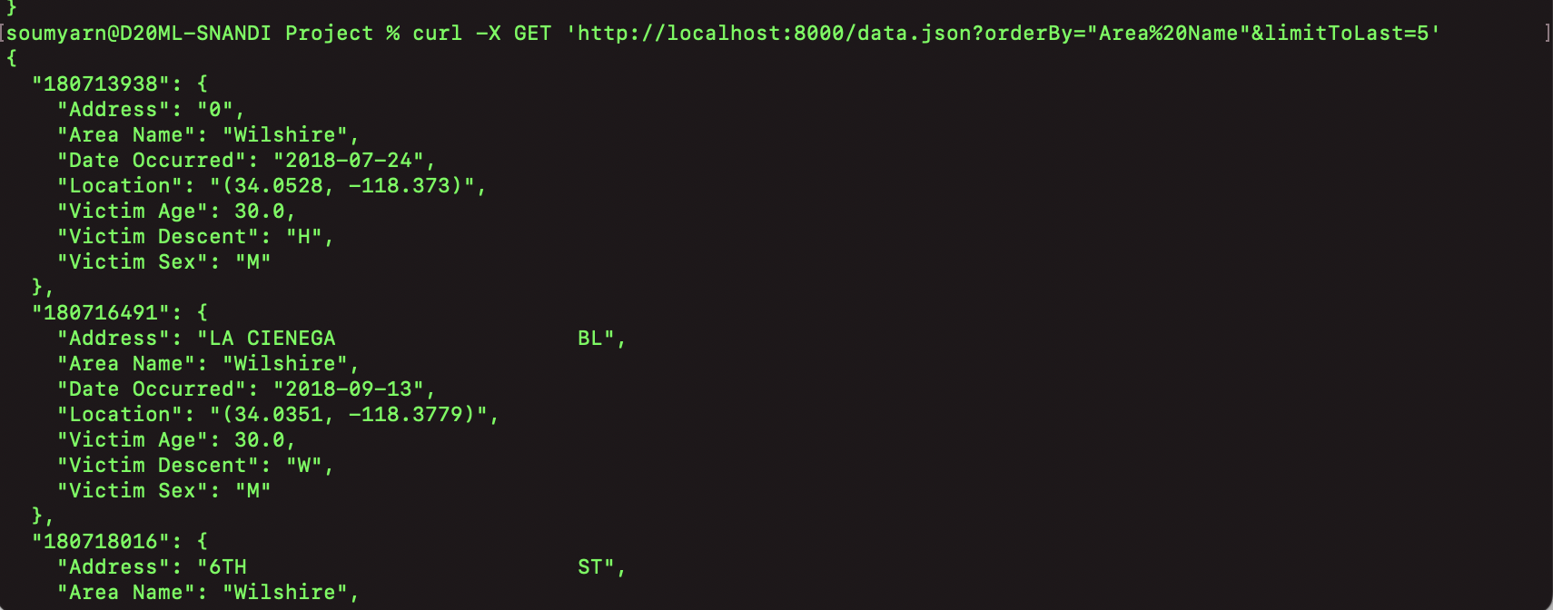
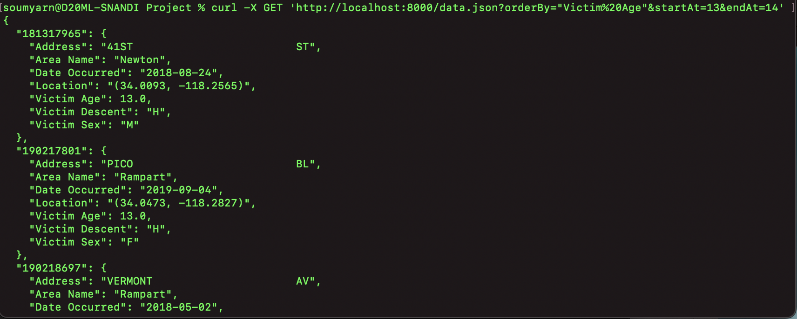
Demonstrations :
curl -X GET 'http://localhost:8000/data.json?orderBy="Area%20Name"&limitToLast=4’
Cc
curl -X GET 'http://localhost:8000/data.json?orderBy="Victim%20Age"&startAt=13&endAt=30’
Notes:
Now lets see some real-time demonstrations of the curl commands working. As shown above, I use the GET method with CURL to sort the data by column Area Name and wish to see the last 5 entries. I have %20 with Area Name because space isn’t allowed to use with URL. Similarly, there;s another GTE command running which sortes the data by ages od vistims, starts at 13 and ends at 30. So roughly this could be helping us to estimate how many students fell victims to traffic accidents in the area and to gauge the traffic safety pinture.

Slide 7
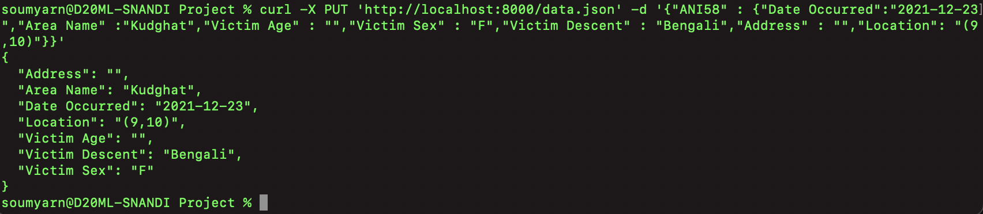
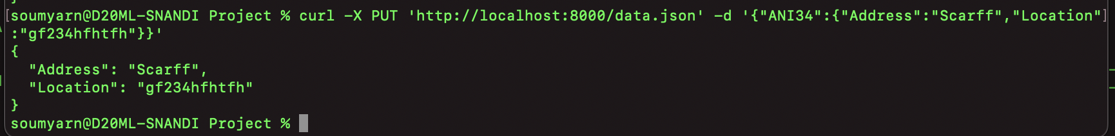
Demonstrations :
curl -X PUT 'http://localhost:8000/data.json' -d '{"ANI58" : {"Date Occurred":"2021-12-23","Area Name" :"Kudghat","Victim Age" : "","Victim Sex" : "F","Victim Descent" : "Bengali","Address" : "","Location": "(9,10)"}}'
curl -X PUT 'http://localhost:8000/data.json' -d ‘{“ANI34” : {{"Address":"Scarff","Location":"gf234hfhtfh"}}’
Notes:
Moving on to the PUT command. In Firebase we can use PUT to both insert new record/update existing record. Similarlu here PUT inserts a new record if it doesn’t exist as well as updates the record if it already exists. The structure of PUT command can have the key either in its path of request or as a part of the data as shown above.

Slide 8

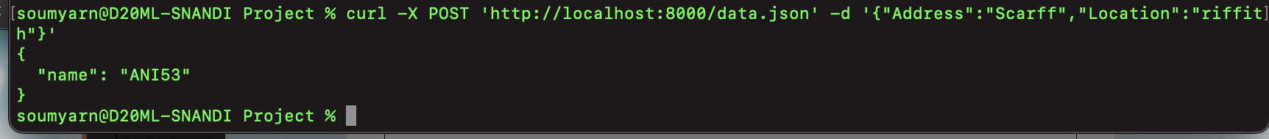
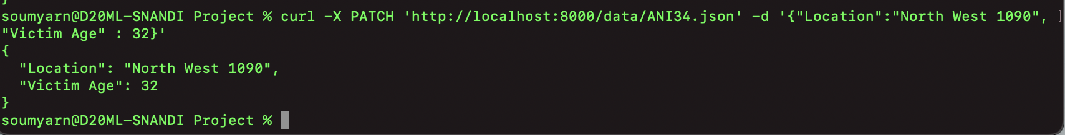

Demonstrations :
POST : curl -X POST 'http://localhost:8000/data.json' -d '{"Address":"Scarff","Location":"riffith"}’
PATCH : curl -X PATCH 'http://localhost:8000/data/ANI34.json' -d '{"Location":"North West 1090", "Victim Age" : 32}’
DELETE : curl -X DELETE 'http://localhost:8000/data/ANI34.json'
Notes:
Some more demonstrations about POST,PATCH and DELETE. I Firebase, a POST command inserts a new record by auto-generating a key for the recod. This key is printed on the terminal as result similarly as above. A PATCH command updates an existing record. Here it retrieves the key from the request path and updates the record with new values for Location and Victim Age. A DELTE command deletes an existing record. The key of the record has been provided in the path like Firebase. Successful deletion prints the status 200 message on terminal.

Slide 9
Challenges and solutions:
Too many columns – focused on specific columns for feasible analysis.
Repeated data retrieval/manipulation often stops the server – restarting the server.
Results take time to be fetched – restarting the server to see faster results.
Notes:
The dataset I got was 2 GB size, too huge, couldn’t load all the columns to MySQL. So I took. Asubset of the data and focused on specific columns to work with for tis project. I noticed that repeated data retrievals/manipulation commands from MySQL sometimes gets the server stuck. To ensure smooth operation, I restart the server when it gets stuck. While working with mukltiple queries, the server might take too long to respond. As a temporary workaround, I shutdown the server and strat it after 5 seconds to see results faster.

Slide 10
Learnings and possible extensions :
Learnings/Key Features:
Clear idea of how a Big Data system works.
MySQL better for multi-row transactions(less latency!)
Less complex queries with Firebase.
Better error handling messages with Firebase.
Firebase works only with JSON data.
Extensions :
Using LONGBLOB in MySQL to store variable amount of data.
Split counter over rows for volatile data.
Use ProxySQL/Vitess for MySQL Sharding/scalability.
Notes:
Perhaps the most imp part : . I now have a clearer picture of how Firebase commands work, gioven that I know the CURL command and the equivalent SQL queries. What I observed was MySQL is better/more suitable for multi-row transactions(less latency). Structure of ueries however is simpler in Firebase. The error handling messages are more user-friendly in Firebase unline MySQL having a huge stack teace. One big constraint with Firebase : works only with JSON data an no other formnat.
Taking ablout Extensions, I plan to use LongBLob in MySQL … read out everything.

Slide 11
THANK YOU

